Slide 1
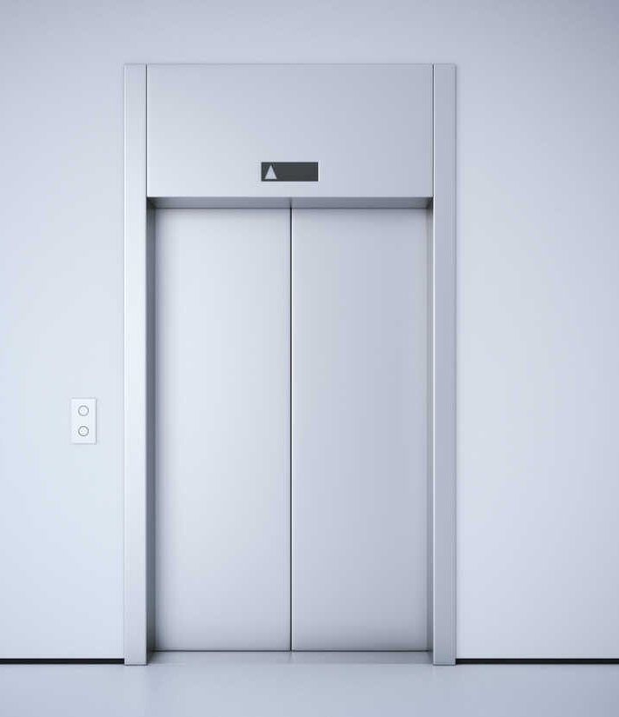
Elevator Optimising
DeepLearning Hackathon
30 Sept 2022 – 3 Oct 2022
sword_turing Team Ryan Gong Zerui, Bryan Lu, Aden Ong, Chang Chieh Hsiang, Chang Ren You
Notes:
Line spacing + Page numbers

Slide 2
Problem statement and Aim
01
Traditional Elevator do not factor in the usage of the elevator based on time or weather. For example, office buildings’ elevator would be frequently used during peek hours such as the start of work, lunch and end of work. Which would add into the traveling time needed for workers to get to their office.
We aim to develop an algorithm based on Machine Learning to better improve the efficiency of traditional elevators.

Slide 3
Current Elevator Algorithm
02
First Come First Serve (FCFS)
Which ever floor presses the button first, the lift would be sent there first, and the order continues
This would cause the elevator to have the highest distance travelled
Shortest Seek Time First (SSTF)
The elevator would travel to the next closest request from its current position
This would reduce the distance travelled. However, floors at the extreme ends would have a very high waiting time
SCAN
When going up/down, it would travel to the next closest request in the direction of the elevator
Able to have the same efficiency as SSTF with no extreme waiting time
Taking requests : 51 64 56 66 17 88 59 12 29 9 as example. Assuming elevator is at the 13 floor
Total distance travelled: 302
Sequence: 13 -> 51 -> 64 -> 56 -> 66 -> 17 -> 88 -> 59 -> 12 -> 29 -> 9
Total distance travelled: 83
Sequence: 13 -> 12 -> 9 -> 17 -> 29 -> 51 -> 56 -> 59 -> 64 -> 66 -> 88
Total distance travelled: 83
Sequence: 13 -> 17 -> 29 -> 51 -> 56 -> 59 -> 64 -> 66 -> 88 -> 12 -> 9

Slide 4
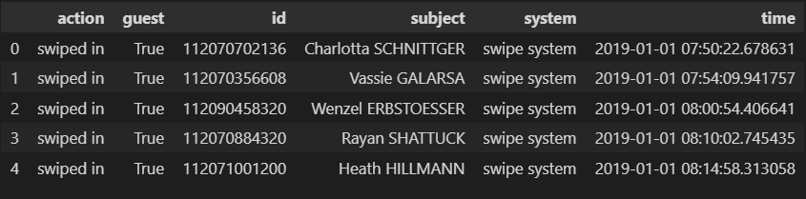
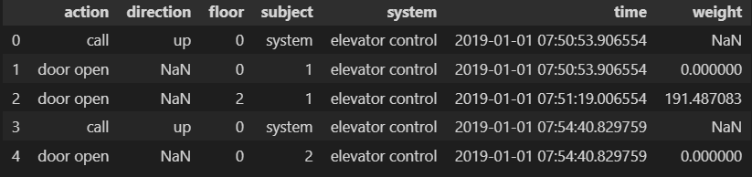
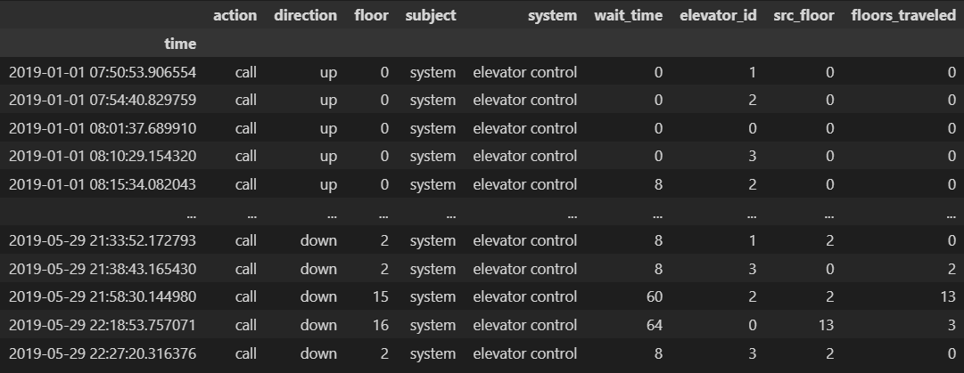
Dataset
03
people.csv dataset documented all of the swipes into the buildings security system
simulation.csv is a long of each elevator’s status and operations, there were total 4 elevators in the 20 story building.
With roughly equal numbers of up and down calls
Using this dataset, we reshape the data to what we need

Slide 6
Training and testing
04

Slide 8
Ours vs Traditional Elevator
05

